Slide 1
HerTechQuest Community Outreach
Usecase Name – Solo Women travel guide
Team 6
1. Prasanna Keerthi S
2. Gayathri G
3. Thejaswini M
8-Dec-2024

Slide 2
Problem Statement
Developing a travel guide with which the user can actively interact and get inputs based on their interests. This model specializes for responding to travelling women without much or any companions.
Decision fatigue
Safety concerns
Emergency situations
Notes:
The intelligent agent would leverage advanced algorithms and machine learning techniques to process and analyze textbook material, distilling the essential information into easily digestible summaries. This would not only save time for students and educators alike but also ensure that key concepts are clearly understood.
Furthermore, the agent would evaluate different teaching methodologies and recommend the best approach for each topic. This personalized teaching strategy would cater to diverse learning styles and maximize the effectiveness of our educational programs.
Lastly, the agent would generate assessment modules aligned with the content, providing comprehensive evaluations to measure student understanding and progress. These assessments would be designed to reinforce learning and identify areas that may require additional focus.

Slide 3
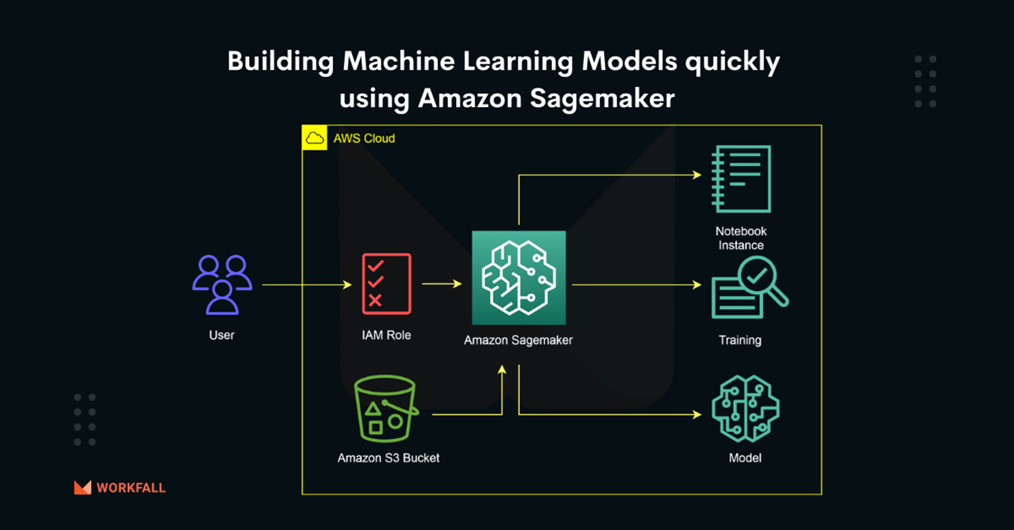
Approach, Solution & Outcome
Approach :

Slide 4
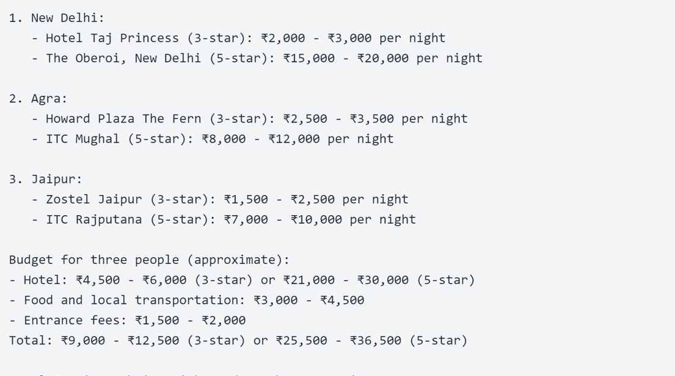
Approach, Solution & Outcome
Solution :
Building a Gen AI model which not only suggests travel assistance but also safety tips for women and additional safety guidelines
Model used: Claude 3.5 Sonnet V2
Outcome:

Slide 5
Demo

Slide 6
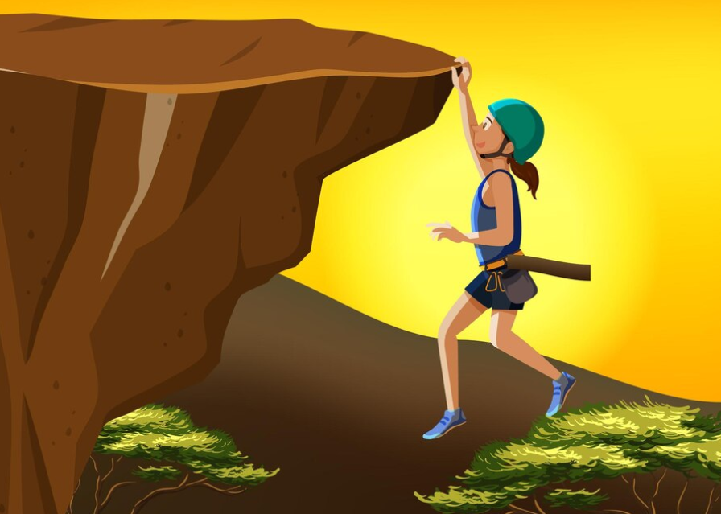
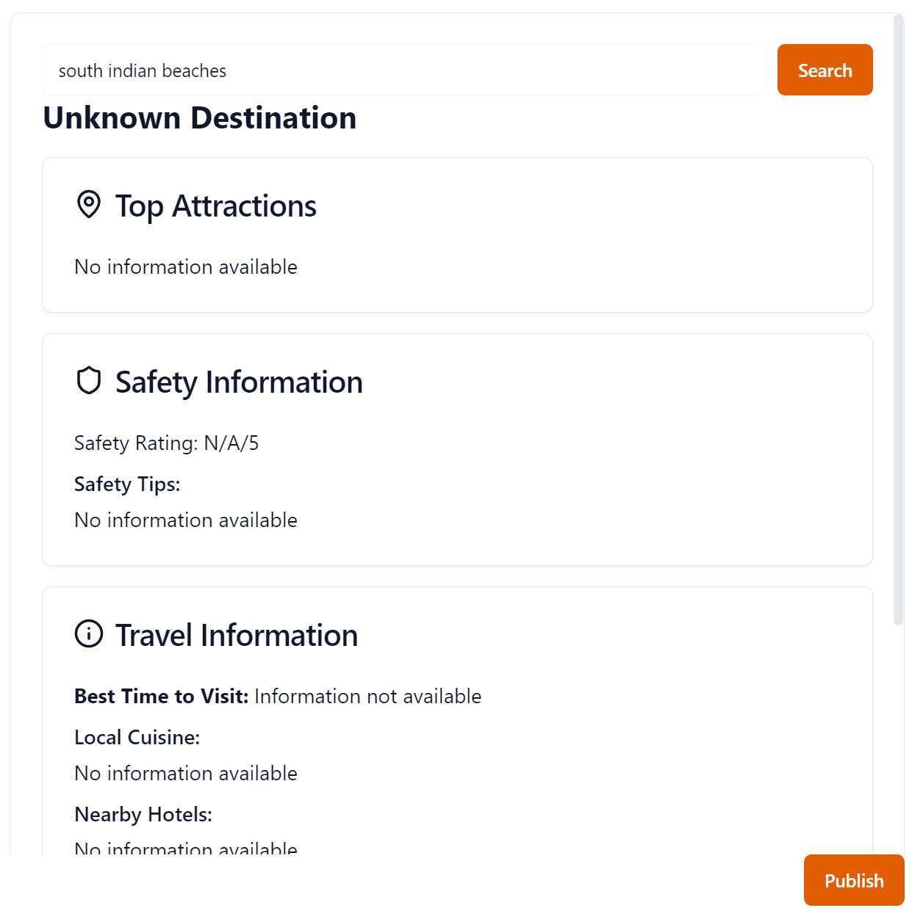
Challenges faced :
Model for training
Difficulty in finding safety ratings for women for public places.
Further Development :
Notes:
Experiment & Metrics

Slide 7
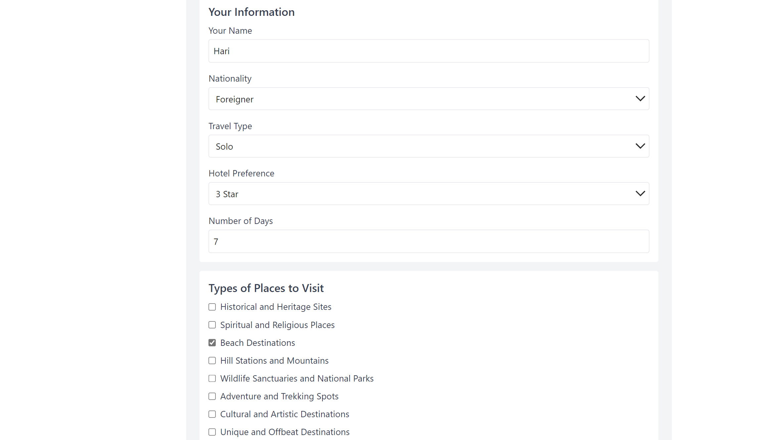
Further Development :

Slide 8
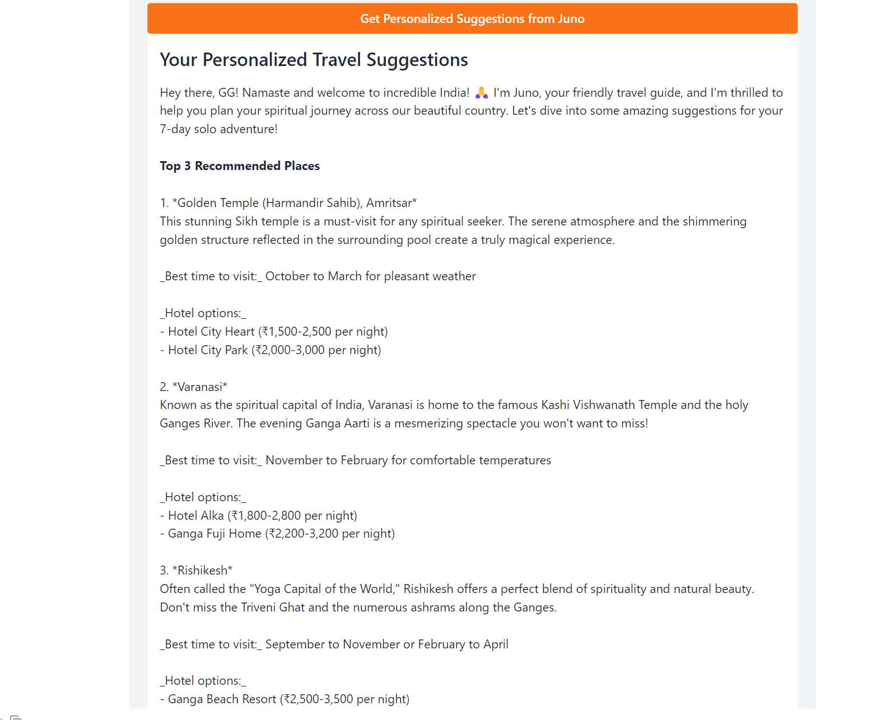
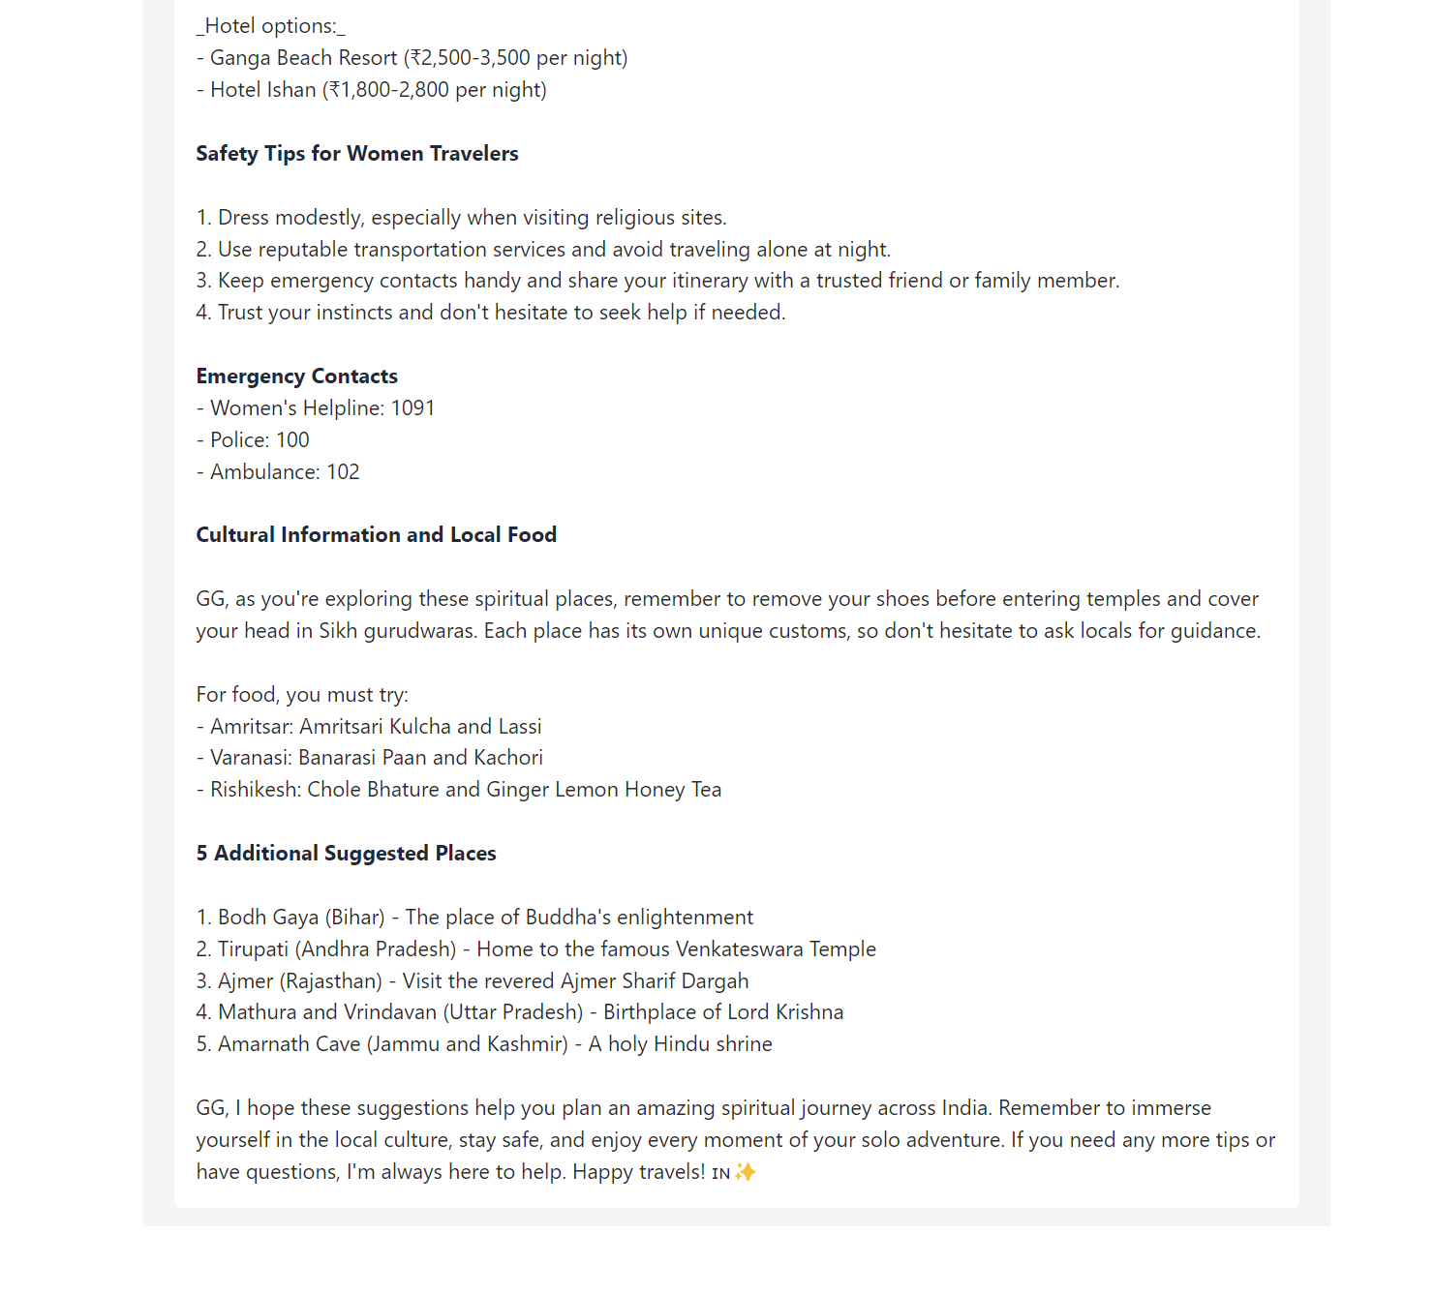
Further Development :

Slide 9
Conclusion
Using our app any single or group of women can travel with various places with confidence and with enough safety precautions
Coding the Future, One Woman at a Time
Notes:
Experiment & Metrics

Slide 10
Thank You

